Slide 1

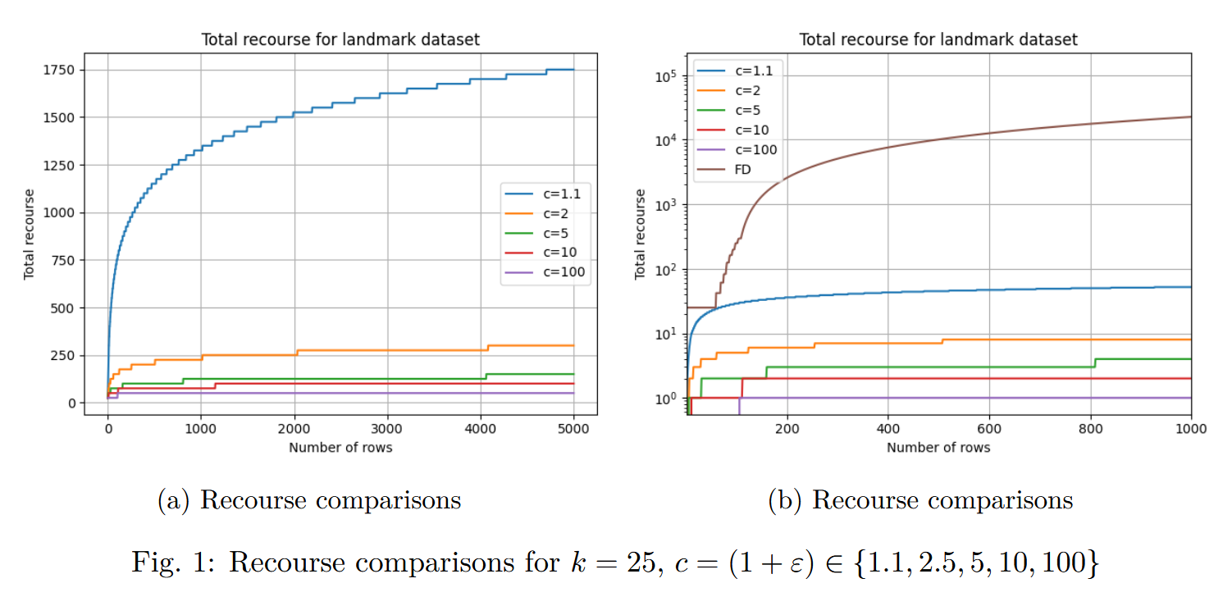
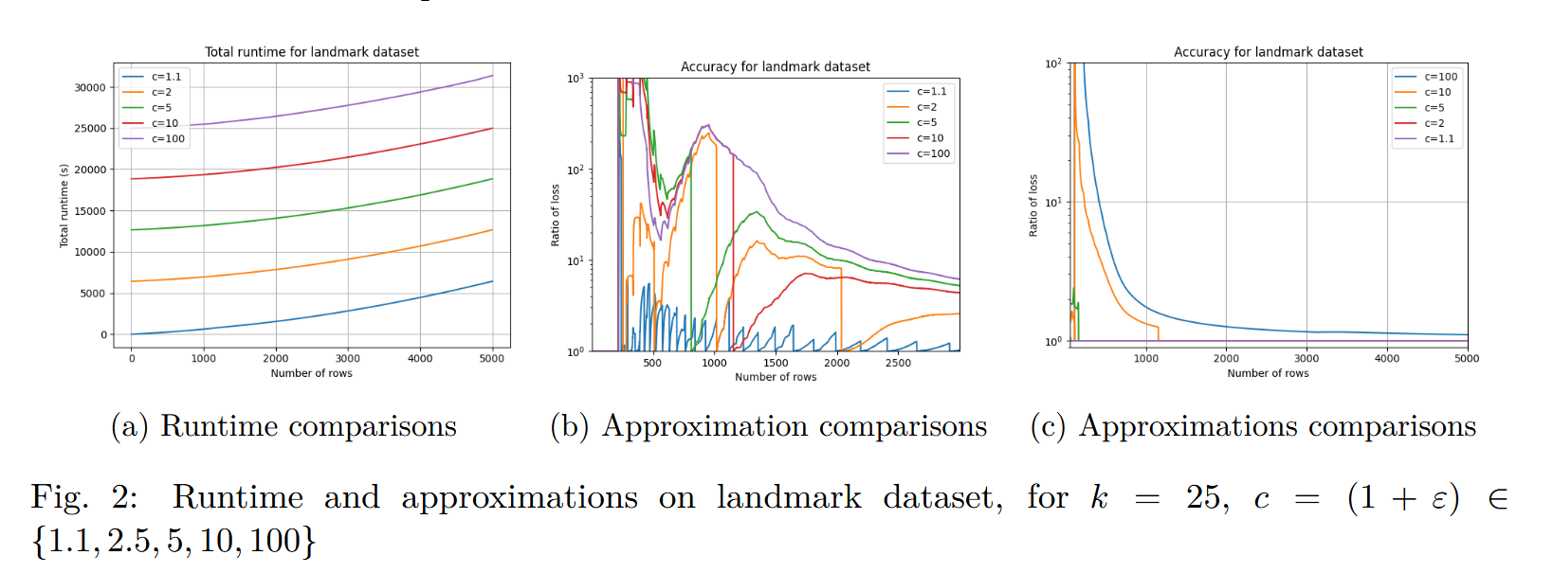
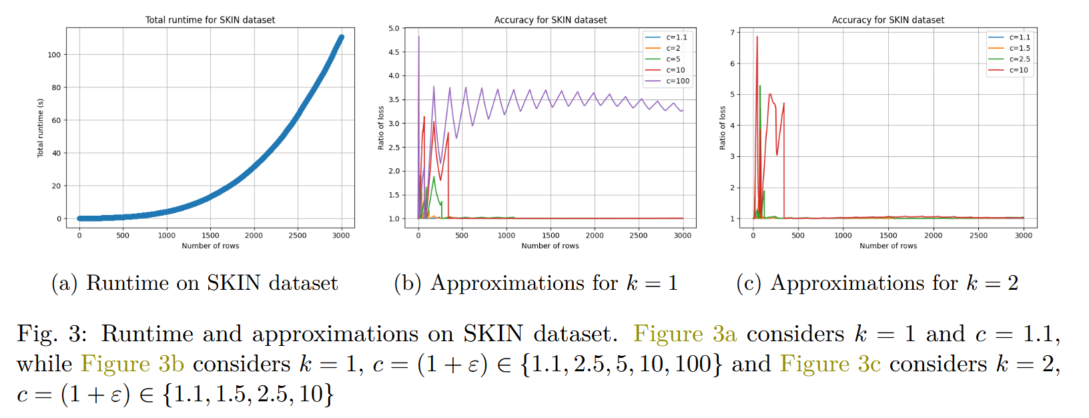
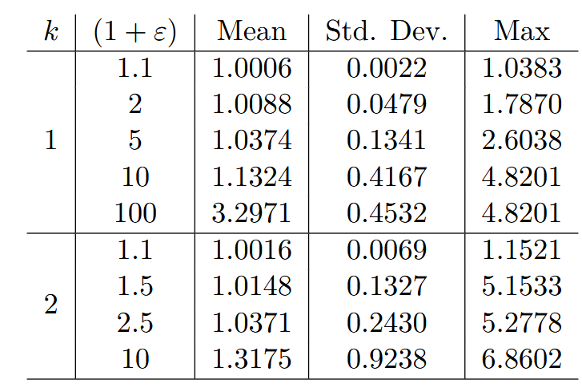
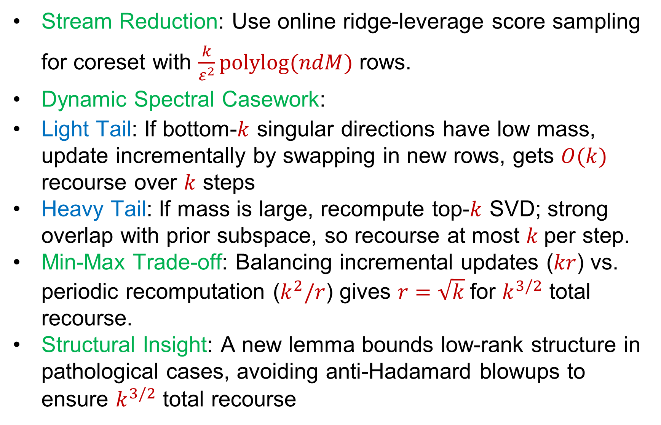
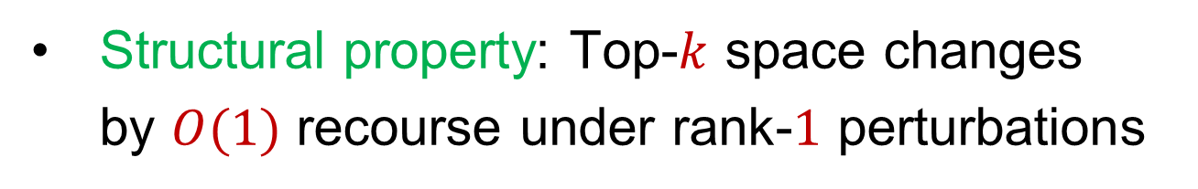
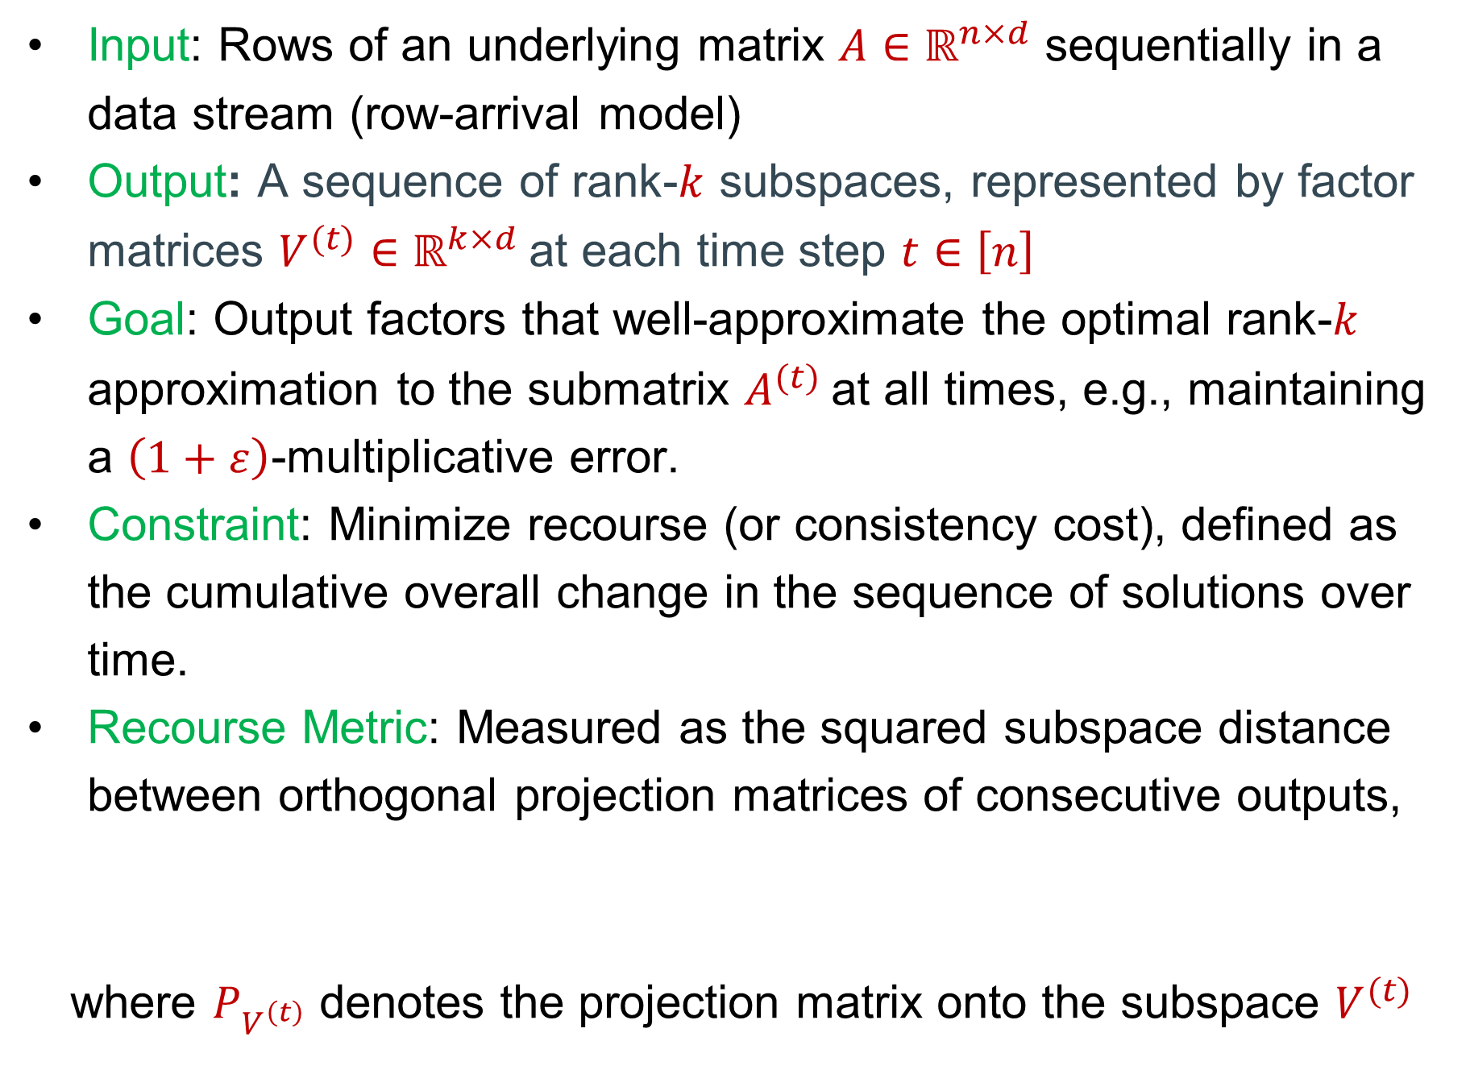
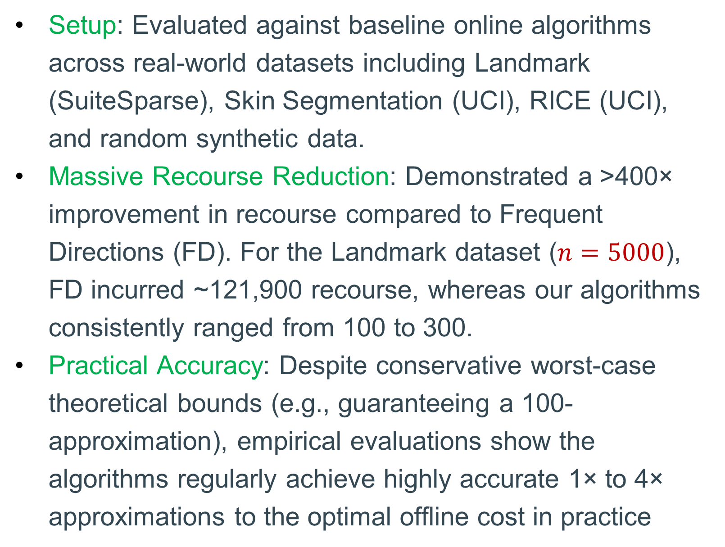
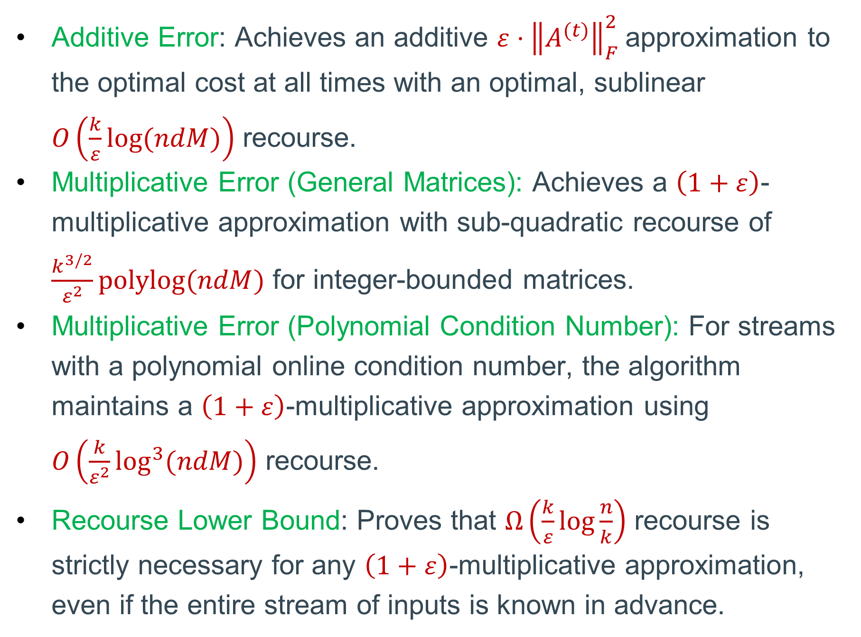
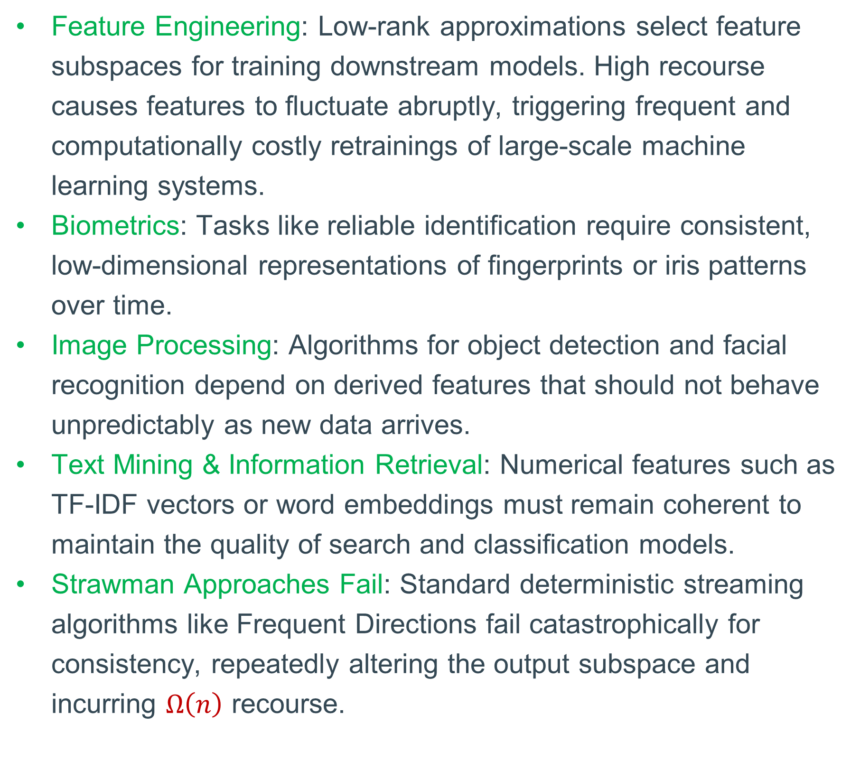
Consistent Low-Rank Approximation
David P. Woodruff (Carnegie Mellon University)
Samson Zhou (Texas A&M University)
Empirical Evaluations
Setup: Evaluated against baseline online algorithms across real-world datasets including Landmark (SuiteSparse), Skin Segmentation (UCI), RICE (UCI), and random synthetic data.
Massive Recourse Reduction: Demonstrated a >400× improvement in recourse compared to Frequent Directions (FD). For the Landmark dataset ($n=5000$), FD incurred ~121,900 recourse, whereas our algorithms consistently ranged from 100 to 300.
Practical Accuracy: Despite conservative worst-case theoretical bounds (e.g., guaranteeing a 100-approximation), empirical evaluations show the algorithms regularly achieve highly accurate 1× to 4× approximations to the optimal offline cost in practice
Our Results
Model
Additive Error: Achieves an additive $ε⋅{\left\|A^{(t)}\right\|}_{F}^{2}$approximation to the optimal cost at all times with an optimal, sublinear $O\left(\frac{k}{ε}log⁡(ndM)\right)$ recourse.
Multiplicative Error (General Matrices): Achieves a $\left(1+ε\right)$-multiplicative approximation with sub-quadratic recourse of $\frac{k^{3/2}}{ε^{2}}polylog⁡(ndM)$ for integer-bounded matrices.
Multiplicative Error (Polynomial Condition Number): For streams with a polynomial online condition number, the algorithm maintains a $\left(1+ε\right)$-multiplicative approximation using $O\left(\frac{k}{ε^{2}}\log^{3}{(ndM)}\right)$ recourse.
Recourse Lower Bound: Proves that $Ω\left(\frac{k}{ε}\log{\frac{n}{k}}\right)$ recourse is strictly necessary for any $\left(1+ε\right)$-multiplicative approximation, even if the entire stream of inputs is known in advance.
Input: Rows of an underlying matrix $A∈ℝ^{n×d}$ sequentially in a data stream (row-arrival model)
Output: A sequence of rank-$k$ subspaces, represented by factor matrices $V^{(t)}∈ℝ^{k×d}$at each time step $t∈\left[n\right]$
Goal: Output factors that well-approximate the optimal rank-$k$ approximation to the submatrix $A^{(t)}$at all times, e.g., maintaining a $\left(1+ε\right)$-multiplicative error.
Constraint: Minimize recourse (or consistency cost), defined as the cumulative overall change in the sequence of solutions over time.
Recourse Metric: Measured as the squared subspace distance between orthogonal projection matrices of consecutive outputs,
where $P_{V^{\left(t\right)}}$ denotes the projection matrix onto the subspace $V^{(t)}$
$\sum_{t=2}^{n}{Recourse}\left(V^{(t)},V^{(t−1)}\right)=\sum_{t=2}^{n}{{\left\|P_{V^{\left(t\right)}}−P_{V^{\left(t−1\right)}}\right\|}_{F}^{2}}$,
Applications / Motivations
Algorithm (General Matrices)
Feature Engineering: Low-rank approximations select feature subspaces for training downstream models. High recourse causes features to fluctuate abruptly, triggering frequent and computationally costly retrainings of large-scale machine learning systems.
Biometrics: Tasks like reliable identification require consistent, low-dimensional representations of fingerprints or iris patterns over time.
Image Processing: Algorithms for object detection and facial recognition depend on derived features that should not behave unpredictably as new data arrives.
Text Mining & Information Retrieval: Numerical features such as TF-IDF vectors or word embeddings must remain coherent to maintain the quality of search and classification models.
Strawman Approaches Fail: Standard deterministic streaming algorithms like Frequent Directions fail catastrophically for consistency, repeatedly altering the output subspace and incurring $Ω\left(n\right)$ recourse.
Stream Reduction: Use online ridge-leverage score sampling for coreset with $\frac{k}{ε^{2}}polylog⁡(ndM)$ rows.
Dynamic Spectral Casework:
Light Tail: If bottom-$k$ singular directions have low mass, update incrementally by swapping in new rows, gets $O(k)$ recourse over $k$ steps
Heavy Tail: If mass is large, recompute top-$k$ SVD; strong overlap with prior subspace, so recourse at most $k$per step.
Min-Max Trade-off: Balancing incremental updates ($kr$) vs. periodic recomputation ($k^{2}/r$) gives $r=\sqrt{k}$for $k^{3/2}$ total recourse.
Structural Insight: A new lemma bounds low-rank structure in pathological cases, avoiding anti-Hadamard blowups to ensure $k^{3/2}$ total recourse
Algorithm (Condition Number)
Structural property: Top-$k$ space changes by $O(1)$ recourse under rank-$1$ perturbations

